Slide 1
Algorithm Analysis
Lecture # 4

Slide 2
Introduction
Algorithms are designed to solve problems, but a given problem can have many different solutions.
How then are we to determine which solution is the most efficient for a given problem?
One approach is to measure the execution time, but the execution time is dependent on several factors.
Input data
Hardware
programming language and compiler

Slide 3
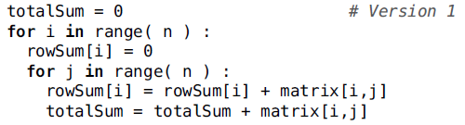
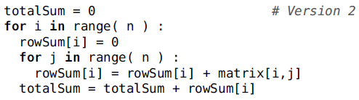
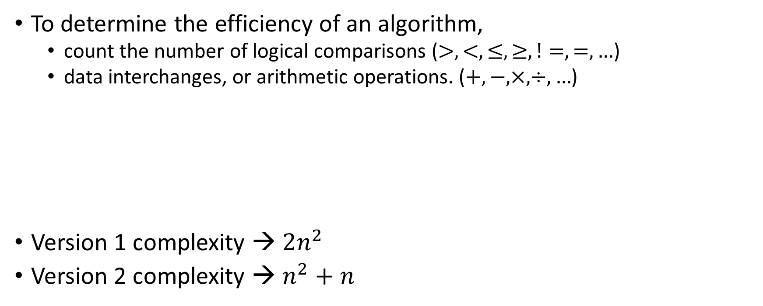
Complexity Analysis
To determine the efficiency of an algorithm,
count the number of logical comparisons ($>,<,≤,≥,!=,=,…$)
data interchanges, or arithmetic operations. ($+,−,×,÷,…$)
Version 1 complexity → $2n^{2}$
Version 2 complexity → $n^{2}+n$

Slide 4
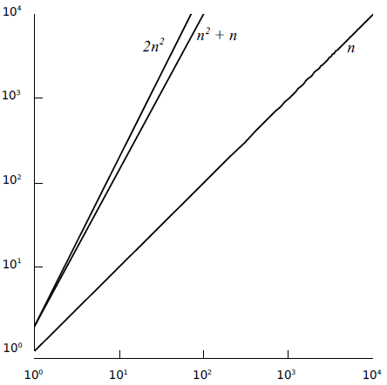
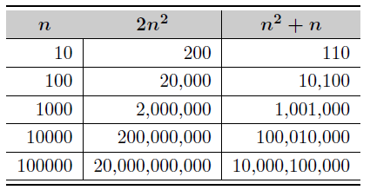

Complexity Analysis
Version 1 complexity → $2n^{2}$
Version 2 complexity → $n^{2}+n$

Slide 5

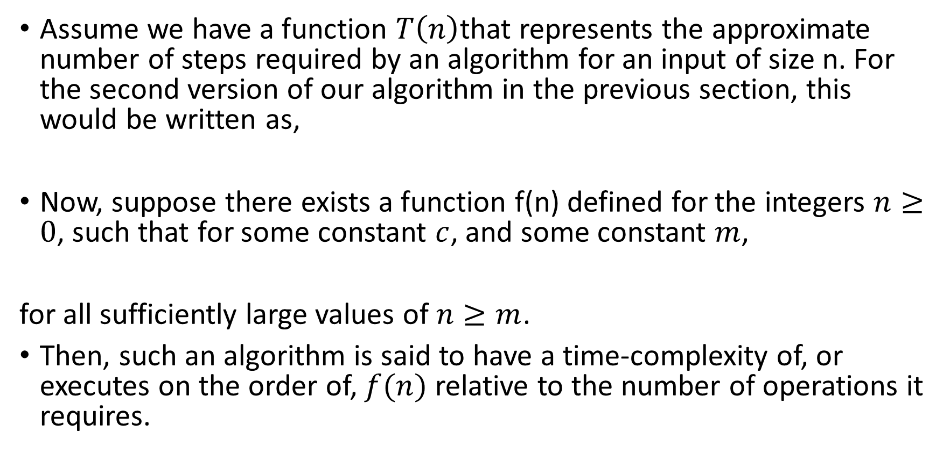

Complexity Analysis – Big ‘O’ notation
Assume we have a function $T\left(n\right)$that represents the approximate number of steps required by an algorithm for an input of size n. For the second version of our algorithm in the previous section, this would be written as,
Now, suppose there exists a function f(n) defined for the integers $n≥0$, such that for some constant $c$, and some constant $m$,
for all sufficiently large values of $n≥m$.
Then, such an algorithm is said to have a time-complexity of, or executes on the order of, $f(n)$ relative to the number of operations it requires.
$$T\left(n\right)=n^{2}+n$$
$$T\left(n\right)≤cf(n)$$

Slide 6

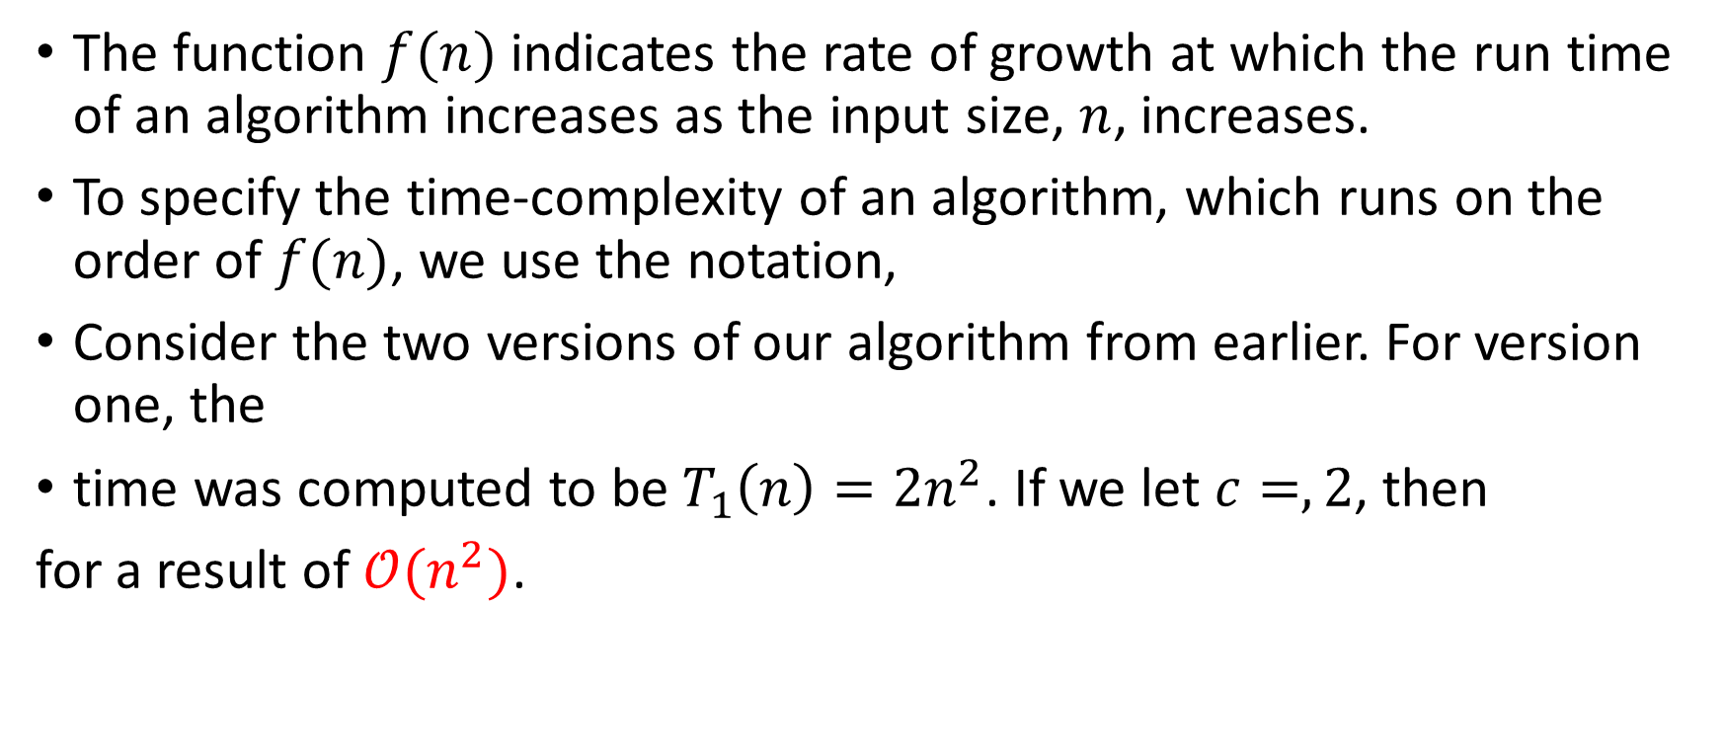

Complexity Analysis – Big ‘O’ notation
The function $f(n)$ indicates the rate of growth at which the run time of an algorithm increases as the input size, $n$, increases.
To specify the time-complexity of an algorithm, which runs on the order of $f(n)$, we use the notation,
Consider the two versions of our algorithm from earlier. For version one, the
time was computed to be $T_{1}\left(n\right)=2n^{2}$. If we let $c=,2$, then
for a result of $𝒪(n^{2})$.
$$𝒪(f\left(n\right))$$
$$2n^{2}≤2n^{2}$$

Slide 7
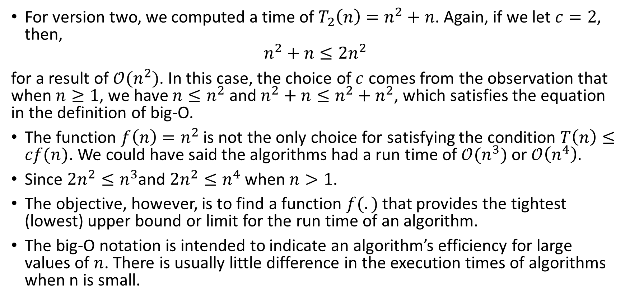
Complexity Analysis – Big ‘O’ notation
For version two, we computed a time of $T_{2}\left(n\right)=n^{2}+n$. Again, if we let $c=2$, then,
$$n^{2}+n≤2n^{2}$$
for a result of $𝒪(n^{2})$. In this case, the choice of $c$ comes from the observation that when $n≥1$, we have $n≤n^{2}$ and $n^{2}+n≤n^{2}+n^{2}$, which satisfies the equation in the definition of big-O.
The function $f\left(n\right)=n^{2}$ is not the only choice for satisfying the condition $T\left(n\right)≤cf(n)$. We could have said the algorithms had a run time of $𝒪(n^{3})$ or $𝒪\left(n^{4}\right).$
Since $2n^{2}≤n^{3}$and $2n^{2}≤n^{4}$ when $n>1$.
The objective, however, is to find a function $f(.)$ that provides the tightest (lowest) upper bound or limit for the run time of an algorithm.
The big-O notation is intended to indicate an algorithm’s efficiency for large values of $n$. There is usually little difference in the execution times of algorithms when n is small.

Slide 8
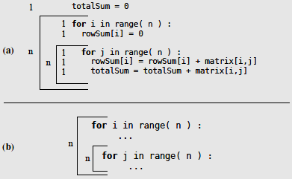
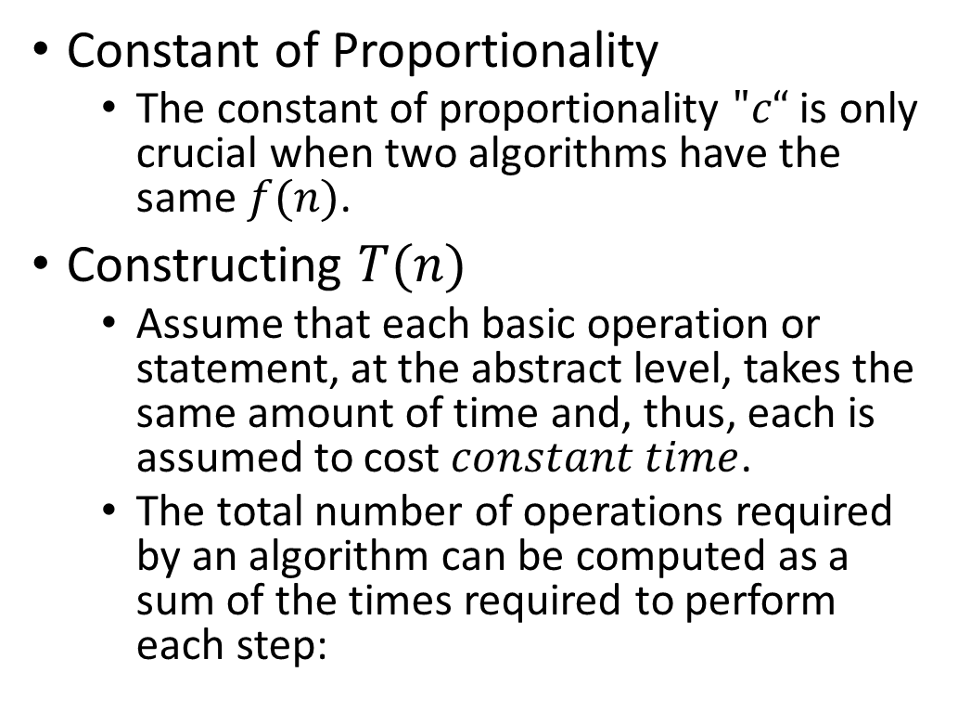
Complexity Analysis
Constant of Proportionality
The constant of proportionality $"c“$ is only crucial when two algorithms have the same $f(n)$.
Constructing $T(n)$
Assume that each basic operation or statement, at the abstract level, takes the same amount of time and, thus, each is assumed to cost $constant time$.
The total number of operations required by an algorithm can be computed as a sum of the times required to perform each step:

Slide 9

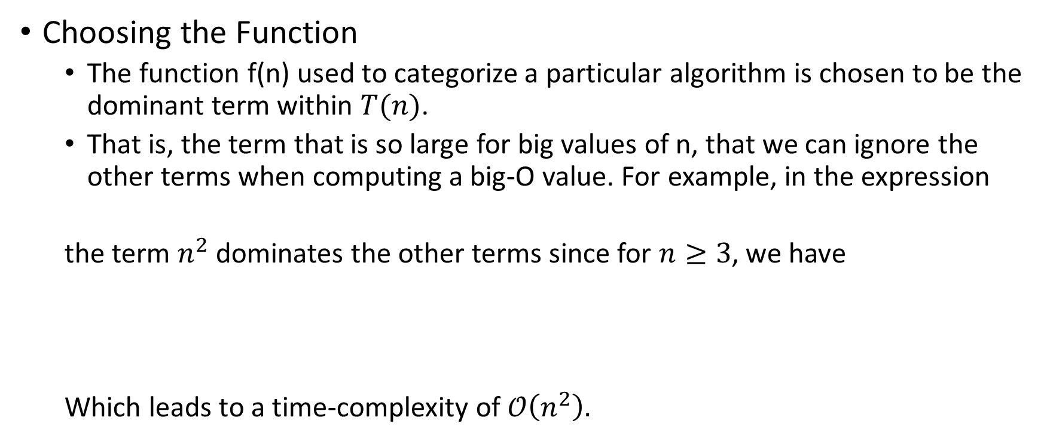
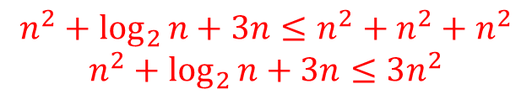
Complexity Analysis
Choosing the Function
The function f(n) used to categorize a particular algorithm is chosen to be the dominant term within $T(n)$.
That is, the term that is so large for big values of n, that we can ignore the other terms when computing a big-O value. For example, in the expression
the term $n^{2}$ dominates the other terms since for $n≥3$, we have
Which leads to a time-complexity of $𝒪\left(n^{2}\right).$
$$n^{2}+\log_{2}{n}+3n$$
$$n^{2}+\log_{2}{n}+3n≤n^{2}+n^{2}+n^{2}$$
$$n^{2}+\log_{2}{n}+3n≤3n^{2}$$

Slide 10
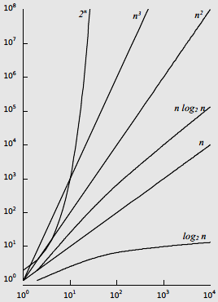
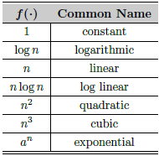
Complexity Analysis
Classes of Algorithms

Slide 11
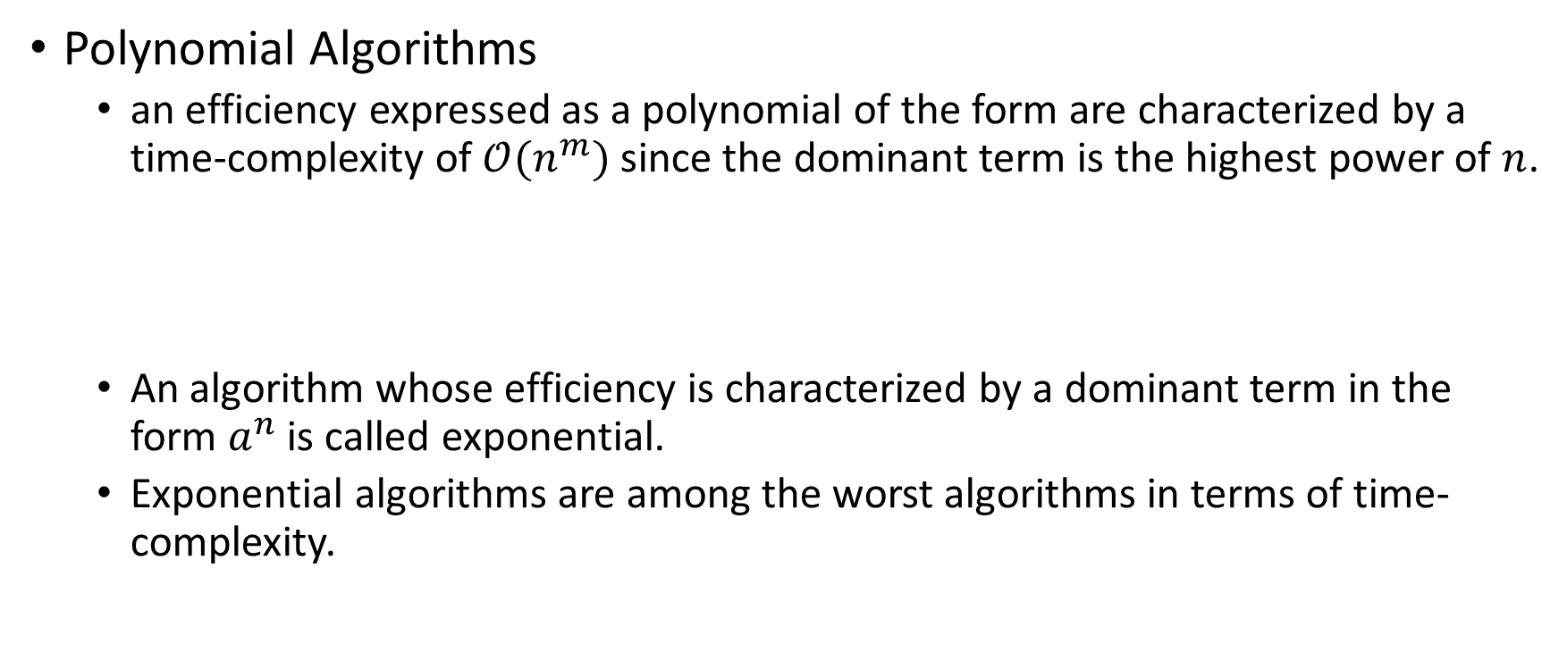
Complexity Analysis
Polynomial Algorithms
an efficiency expressed as a polynomial of the form are characterized by a time-complexity of $𝒪(n^{m})$ since the dominant term is the highest power of $n$.
An algorithm whose efficiency is characterized by a dominant term in the form $a^{n}$ is called exponential.
Exponential algorithms are among the worst algorithms in terms of time-complexity.
$$a_{m}n^{m}+a_{m−1}n^{m−1}+a_{m−2}n^{m−2}+…+a_{2}n^{2}+a_{1}n+a_{0}$$

Slide 12
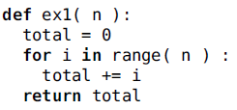
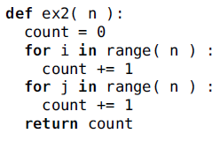

Evaluating Python Code
Constant Time
$𝒪(1)$
Linear Time
$T\left(n\right)=n, 𝒪\left(n\right)$
$T\left(n\right)=n+n=2n,𝒪(n)$

Slide 13
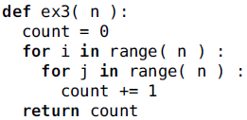
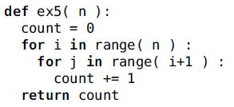

Evaluating Python Code
Quadratic Time Examples
$T\left(n\right)=n∗n=n^{2},𝒪(n^{2})$
$T\left(n\right)=n, 𝒪(n)$
$T\left(n\right)=\frac{n(n+1)}{2}=\frac{n^{2}+n}{2},𝒪(n^{2})$

Slide 14
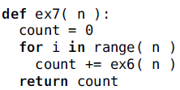

Evaluating Python Code
Logarithmic Time Examples
$T\left(n\right)=\left\lfloor \log_{2}{n}\right\rfloor +1,𝒪(\log_{2}{n})$
$𝒪(n\log_{2}{n})$
def ex6( n ):
count = 0
i = n
while i >= 1 :
count += 1
i = i // 2
return count

Slide 15
Complexity Analysis – Different cases
Some algorithms can have run times that are different orders of magnitude for different sets of inputs of the same size.
These algorithms can be evaluated for their best, worst, and average cases.
Algorithms that have different cases can typically be identified by the inclusion of an event-controlled loop or a conditional statement.

Slide 16
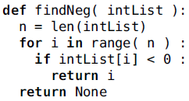
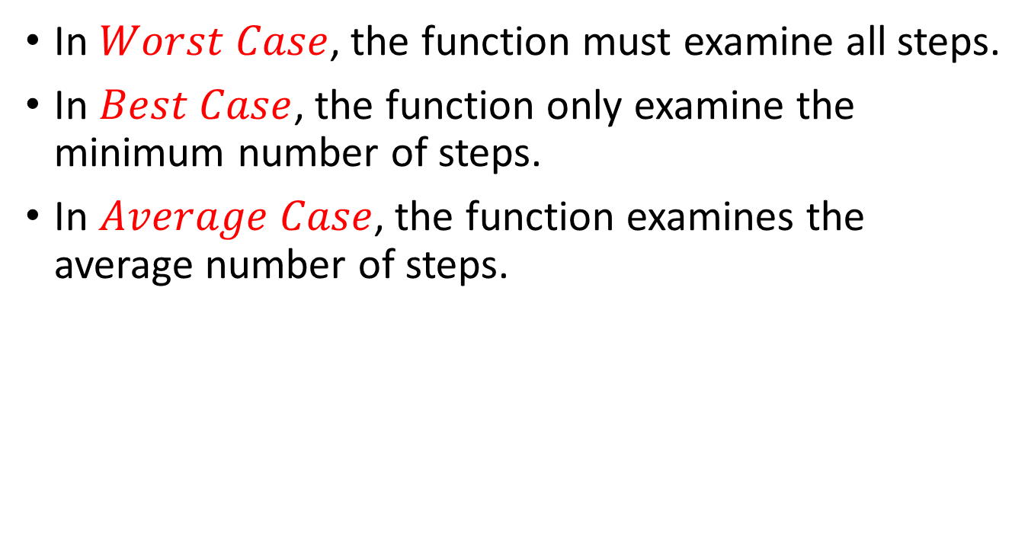
Complexity Analysis – Different cases
In $Worst Case$, the function must examine all steps.
In $Best Case$, the function only examine the minimum number of steps.
In $Average Case$, the function examines the average number of steps.

Slide 17
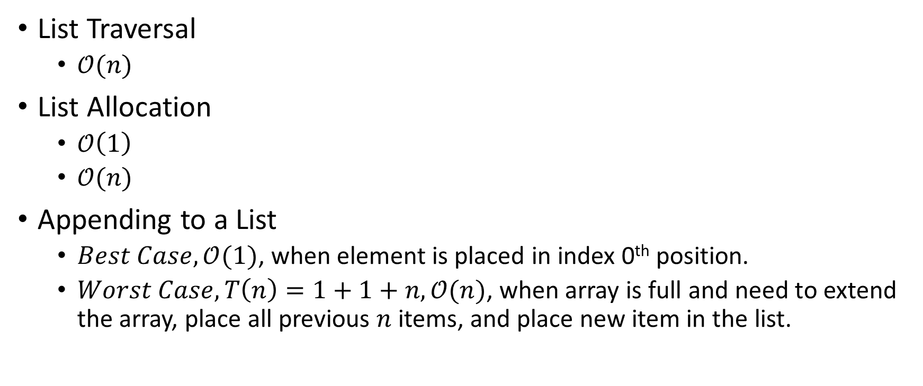
Evaluating the Python List
List Traversal
$𝒪(n)$
List Allocation
$𝒪\left(1\right)$
$𝒪(n)$
Appending to a List
$Best Case, 𝒪(1)$, when element is placed in index 0th position.
$Worst Case, T\left(n\right)=1+1+n,𝒪(n)$, when array is full and need to extend the array, place all previous $n$ items, and place new item in the list.

Slide 18
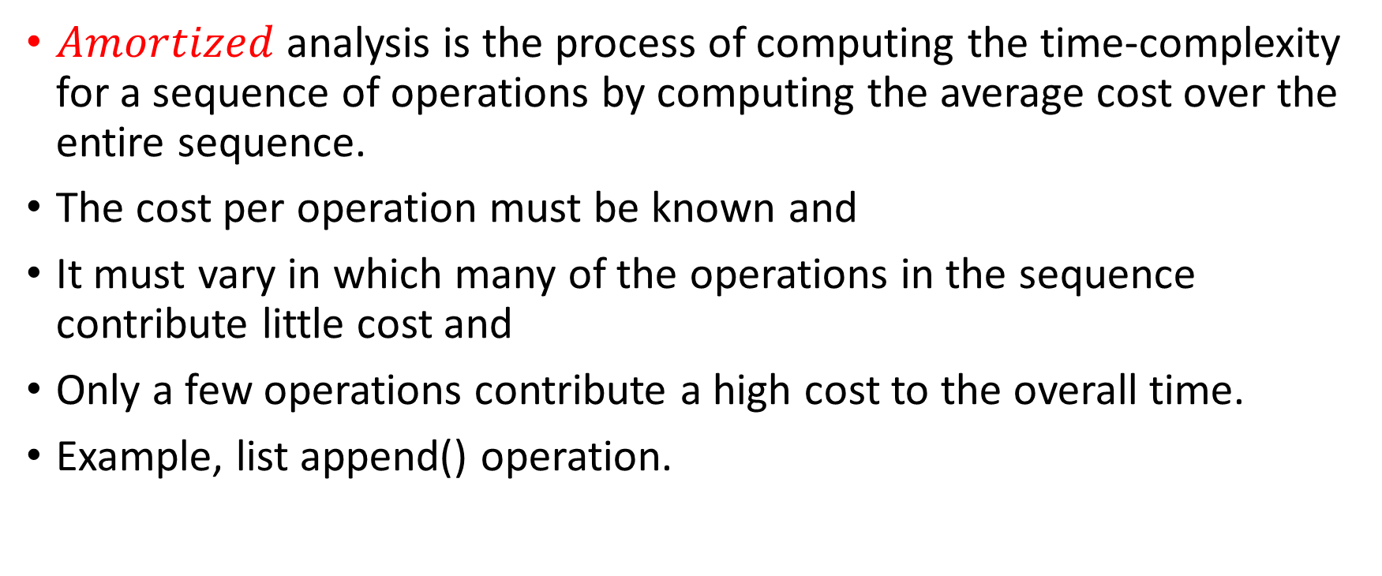
Complexity Analysis - Amortized Cost
$Amortized$ analysis is the process of computing the time-complexity for a sequence of operations by computing the average cost over the entire sequence.
The cost per operation must be known and
It must vary in which many of the operations in the sequence contribute little cost and
Only a few operations contribute a high cost to the overall time.
Example, list append() operation.

Slide 19
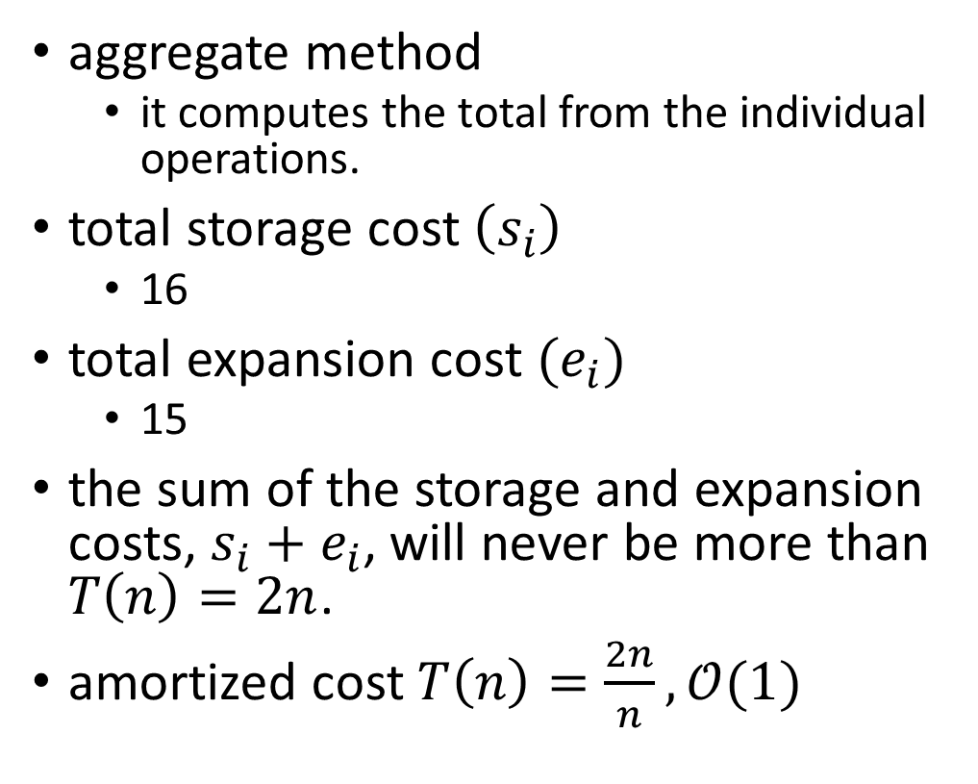
Complexity Analysis - Amortized Cost
aggregate method
it computes the total from the individual operations.
total storage cost $\left(s_{i}\right)$
16
total expansion cost $(e_{i})$
15
the sum of the storage and expansion costs, $s_{i}+e_{i}$, will never be more than $T\left(n\right)=2n$.
amortized cost $T\left(n\right)=\frac{2n}{n}, 𝒪(1)$

Slide 20
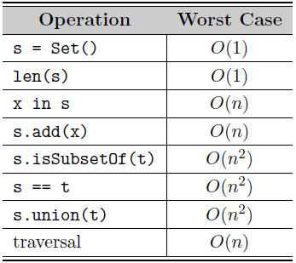
Evaluating the Set ADT

Slide 21
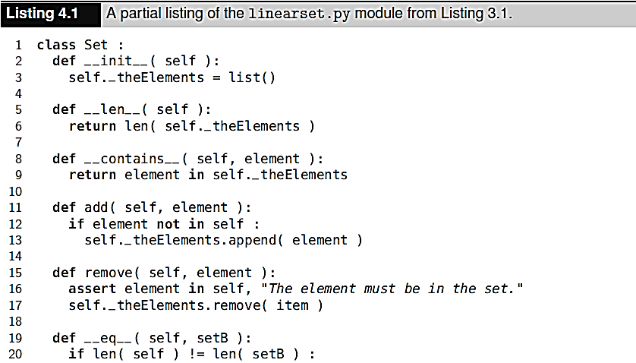
Evaluating the Set ADT

Slide 22
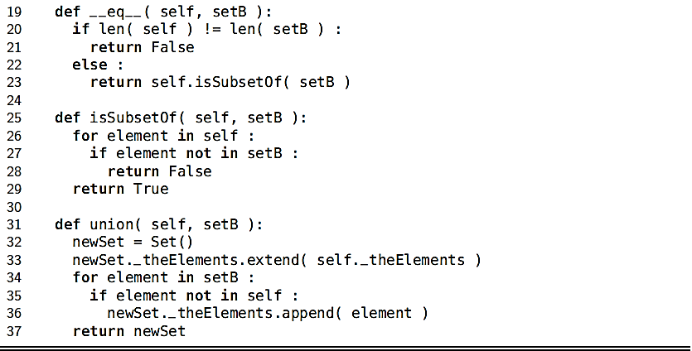
Evaluating the Set ADT

Slide 23
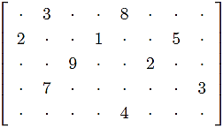
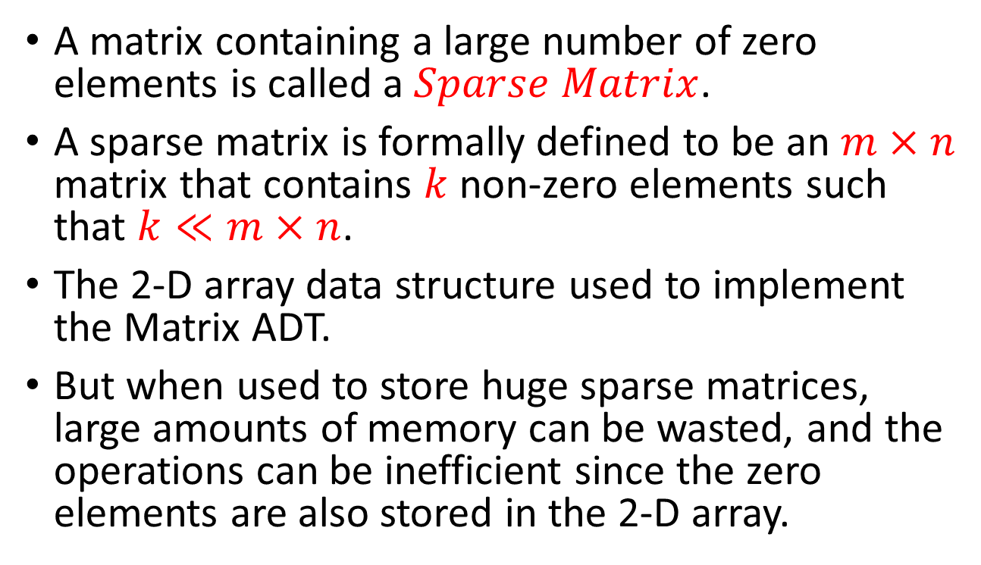
Application: The Sparse Matrix
A matrix containing a large number of zero elements is called a $Sparse Matrix$.
A sparse matrix is formally defined to be an $m×n$ matrix that contains $k$ non-zero elements such that $k≪m×n$.
The 2-D array data structure used to implement the Matrix ADT.
But when used to store huge sparse matrices, large amounts of memory can be wasted, and the operations can be inefficient since the zero elements are also stored in the 2-D array.

Slide 24
Application: The Sparse Matrix
Is there a different structure or organization we can use to store the elements of a sparse matrix that does not waste space?
One approach is to organize and store the non-zero elements of the matrix within a single list instead of a 2-D array.

Slide 25
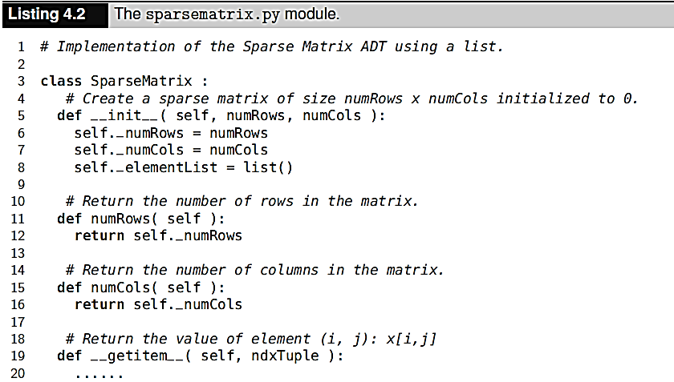
The Sparse Matrix - List-Based Implementation

Slide 26
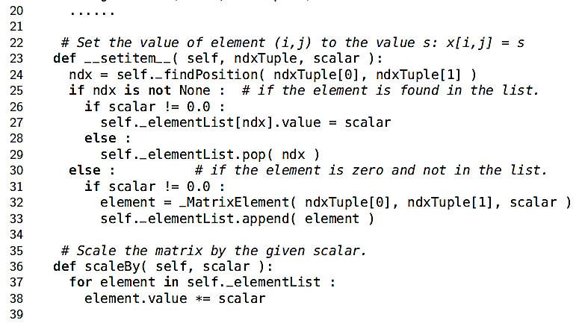
The Sparse Matrix - List-Based Implementation

Slide 27
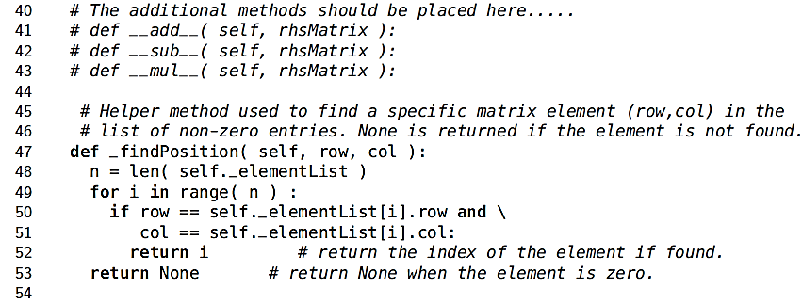
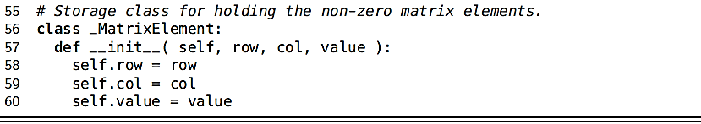
The Sparse Matrix - List-Based Implementation

Slide 28
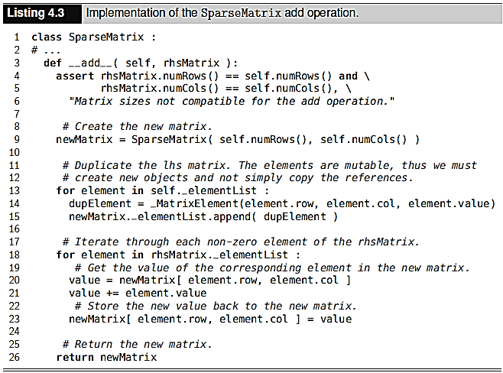
The Sparse Matrix - List-Based Implementation

Slide 29
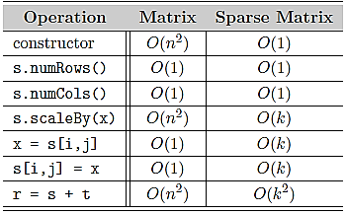
The Sparse Matrix - Efficiency Analysis

